Slide 1
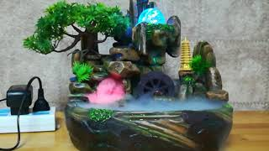
By olivia, audrey, unaysa
Indoor fish tank fountain

Slide 2
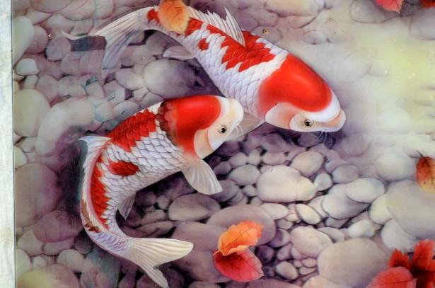
Features!
-The fish tank fountains dimensions are 20cm by 30 cm by 38 cm.
- $55! Affordable!
Perfect for stress! Calming waterfall features with soothing sounds and lights.
-Also humidifies the air, creating a relaxing vibe.

Slide 3
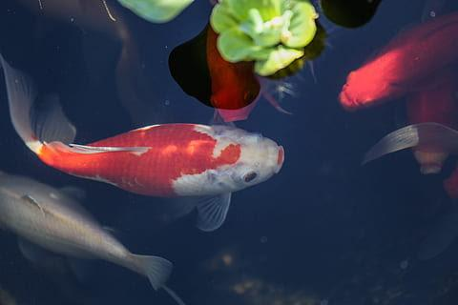
Perfect for elderly people and people who are stressed out
-Easy to set up!
-Relaxing and soothing!
-Science shows it lowers stress by 80%!
-Helps with sleep and anxiety..
-

Slide 4
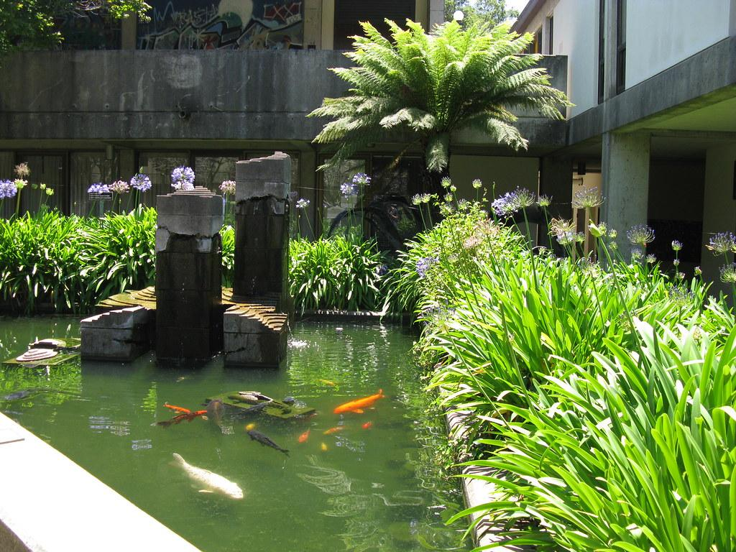


Thank you!

